Slide 1
REAL TIME MAPPING OF EPIDEMIC SPREAD
PIP2001 Capstone Project
Final Review
Batch Number: CSE-15
Roll Number : | Student Name :
20211CSE0218 | Sadiya Mohammedi
20211CSE0835 | Aakif Mohamed Nadeem
20211CSE0333 | Mrinal Raj
20211CSE0713 | Faizeen Shezan
Under the Supervision of,
Ms. Alina Raheen
Assistant Professor
School of Computer Science and Engineering
Presidency University
Name of the Program: CSE
Name of the HoD: Dr . Asif Mohammed H.B
Name of the Program Project Coordinator: Mr. Amarnath J.L & Dr. Jayanthi. K.
Name of the School Project Coordinators: Dr. Sampath A K

Slide 2
Content
1.Abstract
2.Literature Survey – Minimum 10 research papers must be referred.
3.Objectives
4. Existing Methods-Drawbacks
5. Proposed Method
6. Architecture Diagram
7. Modules
8.Hardware and Software Details
9.Time Line by Gantt Chart
10.References
11.Acknowledgement

Slide 3
Abstract
In the face of emerging epidemics, the need for real-time tracking and information dissemination has never been more critical. This project proposes the development of a comprehensive epidemic tracking portal that leverages crowd-sourced data to provide up-to-date insights into epidemic spread and status. Unlike traditional systems that suffer from delayed reporting and limited coverage, our portal ensures timely data collection from diverse sources, including social media, news outlets, and user contributions. To address issues of data noise and misinformation, robust validation mechanisms will filter and verify incoming data, enhancing its reliability. A user-friendly interface will facilitate widespread participation, while strong privacy measures will safeguard user information. By integrating predictive analytics with real-time data, the portal aims to improve the accuracy of epidemic forecasts and alerts. Overall, this solution not only enhances the public's awareness of epidemic developments but also empowers communities to respond effectively to health crises.

Slide 4
Literature Survey
Chandran & Sharma (2020)
Developed machine learning models (decision trees, random forests, SVM) for detecting misinformation on health websites. Emphasized real-time data collection challenges.
Alahakoon & Rojas (2021)
Applied web mining techniques (content-based, structure-based) to detect misinformation. Used metadata and hyperlinks for pattern recognition.
Ranjan & Das (2022)
Proposed an NLP-based system for verifying epidemic information. Utilized entity recognition, sentiment analysis, and text classification.
Kumar & Singh (2023)
Developed a framework using machine learning and deep learning for detecting misinformation on social media. Focused on analyzing social dynamics and content virality.
Mehta & Verma (2022)
Explored deep learning (CNN, RNN) for detecting misinformation in online health articles.
Highlighted the need for large datasets and high computational resources.

Slide 5
Literature Survey
Patel & Gupta (2021)
Conducted a systematic review of tools for monitoring health misinformation. Identified gaps in adaptability and multi-lingual capabilities.
Zhou & Yu (2023)
Introduced a multi-layered engineering approach integrating data from various sources. Used data fusion for accurate real-time misinformation detection.
Sinha & Joshi (2020)
Evaluated existing misinformation detection systems using machine learning and NLP techniques.
Provided insights into system strengths and weaknesses.
Verma & Jain (2021)
Applied data analytics for detecting fake health news on social media.
Analyzed user behavior and content patterns to identify trends.
Bhattacharyya & Paul (2023)
Conducted a comparative study of machine learning, deep learning, and NLP-based detection systems.
Recommended hybrid approaches for better accuracy and scalability.

Slide 6
Objectives
Real-Time Epidemic Monitoring: Provide real-time data on the current status of epidemic spread using crowd-sourced information.
Alert System: Deliver timely alerts to users based on location-specific epidemic developments.
Crowd-Sourced Data Collection: Build a platform that collects and aggregates data from users to enhance the understanding of epidemic spread in real time.
Predictive Analysis: Utilize collected data to forecast the potential future spread of the epidemic.
User-Friendly Interface: Develop a simple, accessible portal that provides an intuitive experience for users to access information and updates.
Data Accuracy and Reliability: Ensure the accuracy and reliability of the crowd-sourced data through validation mechanisms.
Geospatial Mapping: Implement maps to visually represent epidemic spread across regions.
Privacy and Security: Maintain the privacy and security of user-contributed data while providing comprehensive epidemic tracking.

Slide 7
Existing Methods-Drawbacks
Delayed Reporting: Traditional systems are slow due to formal case reporting delays.
Limited Coverage: Many systems fail to capture data from remote or under-reported regions.
Data Noise: Social media-based tracking includes irrelevant and inaccurate information.
Misinformation: High risk of spreading false information from unverified sources like social media.
Inconsistent User Participation: Mobile app-based reporting leads to data gaps due to voluntary input.
Privacy Concerns: Social media and government systems raise privacy and data security issues.
Low Adoption Rates: Contact tracing apps often face low user participation, reducing effectiveness.
High Cost: Wearable devices are expensive, limiting their accessibility to the broader population.
Outdated Information: Web scraping provides delayed or incomplete data from news and health websites.

Slide 8
Proposed Method
Data Collection:
Implement a crowd-sourcing system where users can report their health status and epidemic-related information.
Collect data from multiple sources (e.g., social media, news updates, health organizations).
Real-Time Status Updates:
Build a real-time tracking system to monitor and display the current status of the epidemic on the portal.
Provide continuous updates and status changes to ensure timely dissemination of information.
Alert System:
Develop a location-based alert system that notifies users about local or regional spikes in epidemic cases.
Utilize geospatial data to send alerts based on proximity to affected areas.
Data Aggregation and Processing:
Aggregate the crowd-sourced data to generate rich insights on epidemic patterns.
Use machine learning algorithms to analyze and predict the spread of the epidemic.
Visualization:
Implement geospatial mapping and data visualization tools to represent the spread of the epidemic on a real-time interactive map.

Slide 9
Proposed Method(Continued)
User Interface:
Design a simple, intuitive user interface for users to easily navigate through the portal, view epidemic status, and receive alerts.
Validation and Filtering:
Establish mechanisms to validate the crowd-sourced data to ensure reliability and minimize false information.
Data Security:
Implement robust security measures to protect user data and ensure compliance with privacy standards.

Slide 10
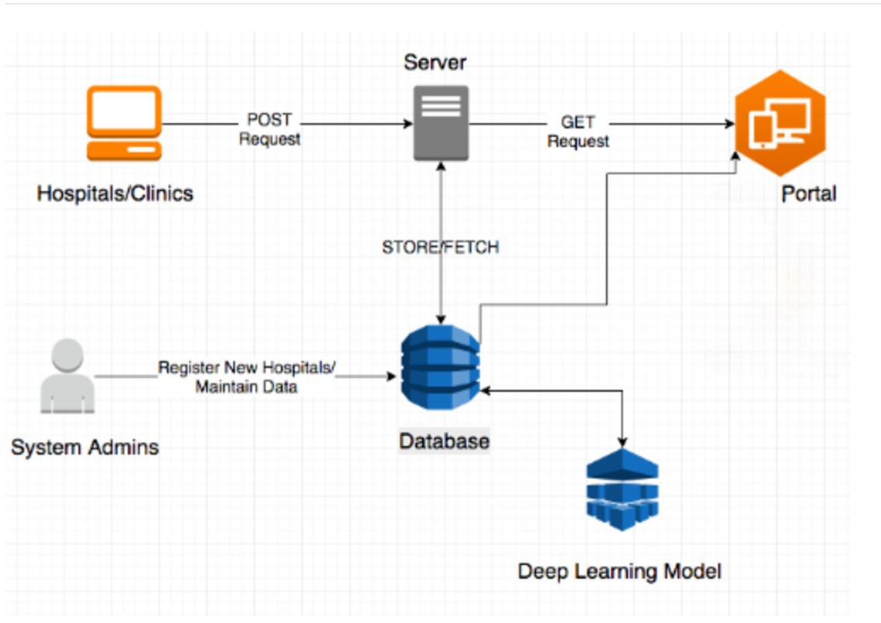
Architecture Diagram

Slide 11
Modules
The modules include:
Data Collection & Mapping: Real-time mapping based on crowdsourced data for epidemic tracking.
Prediction System: Uses machine learning for future epidemic predictions.
Awareness & Alerts: Generates real-time warnings to users.
Hospital/Drugstore Connection: Connects users to nearby healthcare services during outbreaks.
Data Visualization: Heatmaps and clustering for visual representation of data.

Slide 12
Hardware and Software Details
Software :
Operating System – Windows 7/8/10
Server side Script : Python, Java, HTML, MYSQL, CSS, Bootstrap.
Libraries : PANDAS, Flask, Smtlib
IDE : Jupyter Notebook
Hardware :
Processor - I3/Intel Processor
Hard Disk -160GB
Key Board - Standard Windows Keyboard
Mouse - Two or Three Button Mouse
Monitor - SVGA
RAM - 4Gb

Slide 13
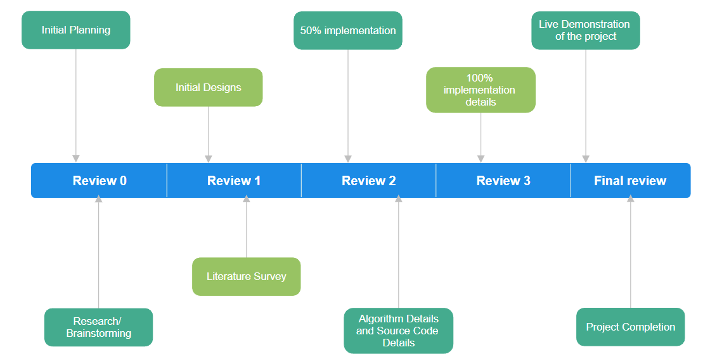
Time Line by Gantt Chart

Slide 14
GitHub link
saad751/project-Real-time-mapping-of-epidemic-spread

Slide 15
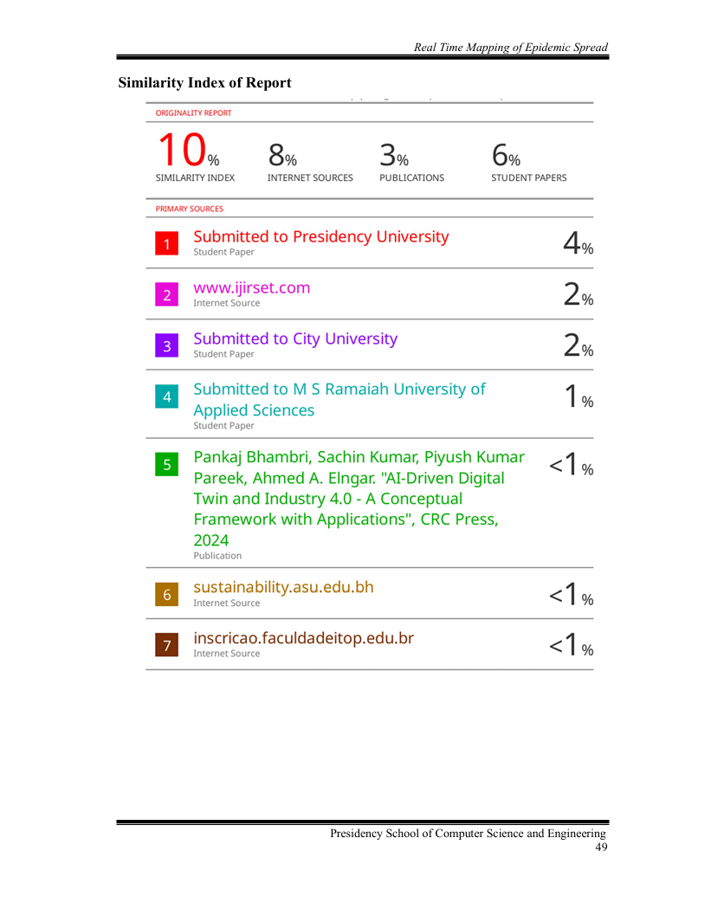
Plagiarism report

Slide 16
References
Chandran, S., & Sharma, A. (2020). "A Machine Learning Approach for Detecting Misinformation on Health Websites." IEEE Access, 8, 117142-117152. DOI: 10.1109/ACCESS.2020.3001446.
Alahakoon, D., & Rojas, L. (2021). "Web Mining Techniques for Detecting Misinformation in Health Related Websites." Journal of Web Engineering, 20(3), 219-236. DOI: 10.13052/jwe.1847-3195.2032.
Ranjan, A., & Das, A. (2022). "Utilizing Natural Language Processing for Epidemic Information Verification." Computers in Biology and Medicine, 145, 105388. DOI: 10.1016/j.compbiomed.2022.105388.
Kumar, V., & Singh, R. (2023). "Framework for Automated Detection of Epidemic Misinformation on Social Media." International Journal of Information Management, 63, 102461. DOI: 10.1016/j.ijinfomgt.2022.102461.
Mehta, R., & Verma, K. (2022). "Detecting Online Health Misinformation Using Deep Learning Techniques." Health Informatics Journal, 28(4), 146045822210794. DOI: 10.1177/14604582221079466.
Patel, J., & Gupta, A. (2021). "A Systematic Review of Tools for Monitoring Health Information on the Web." Journal of Medical Internet Research, 23(6), e23445. DOI: 10.2196/23445.
Zhou, Y., & Yu, X. (2023). "Combating Health Misinformation: An Engineering Approach." Journal of Biomedical Informatics, 139, 104147. DOI: 10.1016/j.jbi.2023.104147.
Sinha, P., & Joshi, S. (2020). "Evaluating Online Health Information: A Study on Misinformation Detection Systems." IEEE Transactions on Information Technology in Biomedicine, 24(5), 1345-1356. DOI: 10.1109/TITB.2020.2994950.
Verma, A., & Jain, P. (2021). "The Role of Data Analytics in Identifying Fake Health News." International Journal of Data Science and Analytics, 12, 145-158. DOI: 10.1007/s41060-020-00236-3.
Bhattacharyya, S., & Paul, M. (2023). "Automated Detection of Health-Related Misinformation: A Comparative Study." Journal of Health Communication, 28(2), 101-112. DOI: 10.1080/10810730.2023.2170346.

Slide 17
Thank You !!

